Slide 1
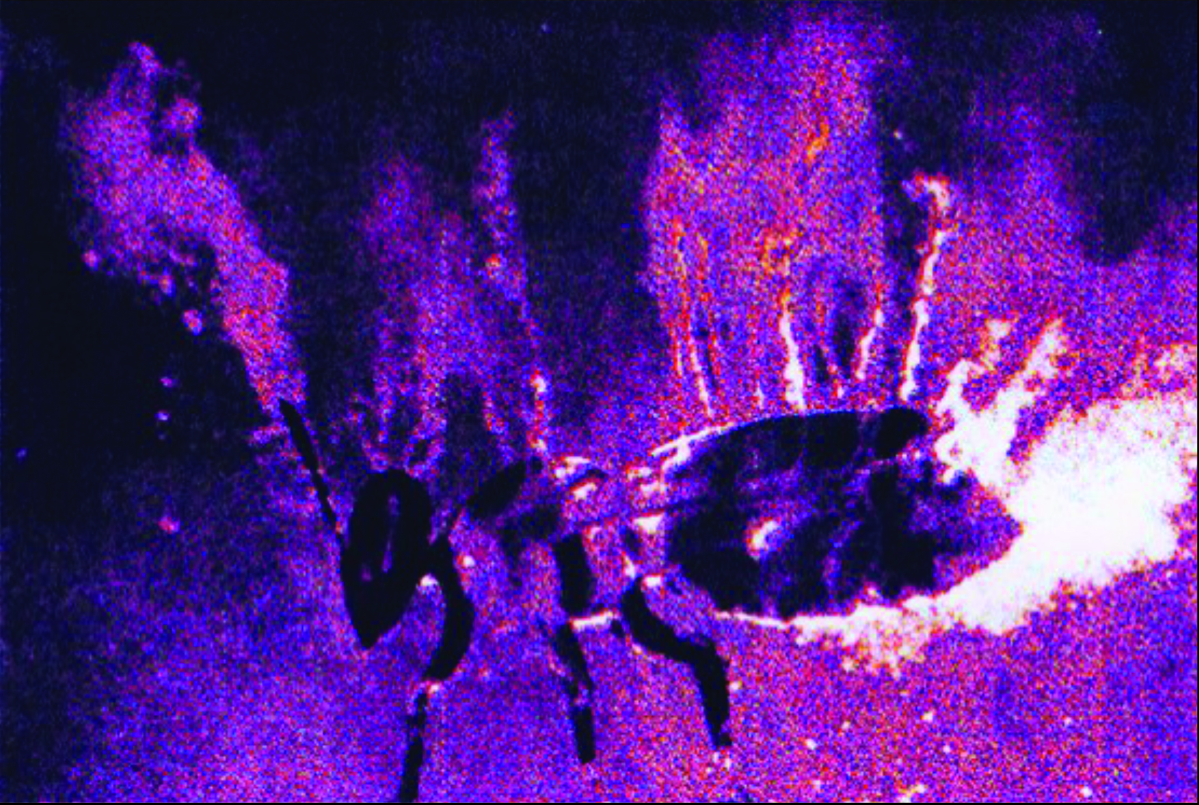
Reception & learning of electric fields in bees
The fact that insects carry an electric charge is well known.
But what is its relevance for the animal?
U. Warnke 1968
C_{s}-Aerosol flux of a charged bee
Notes:
One possible answer to this question is that electric charges have side-effects that bees simply have to live with but have no further meaning. But our studies demonstrate that electric charge plays an important role in honeybee communication.

Slide 2
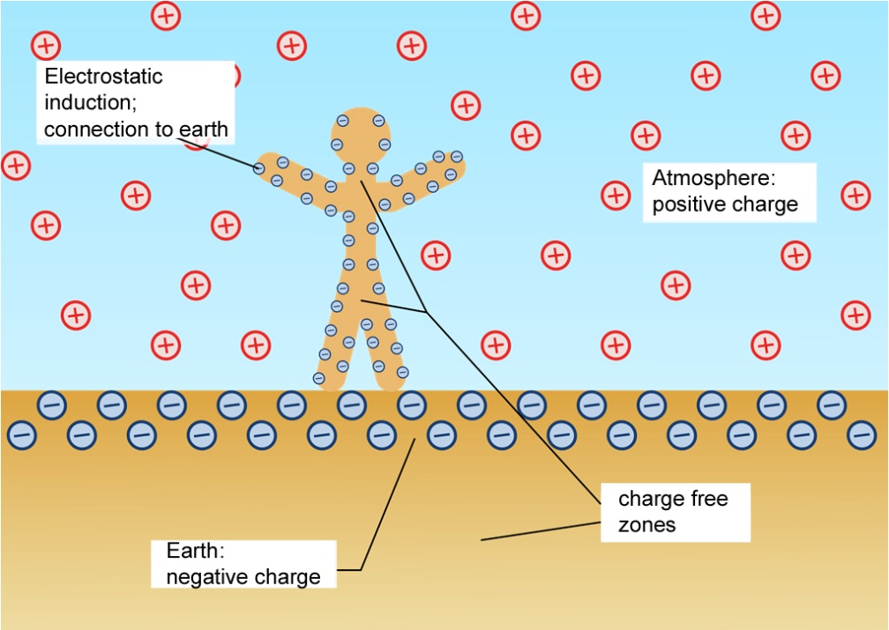
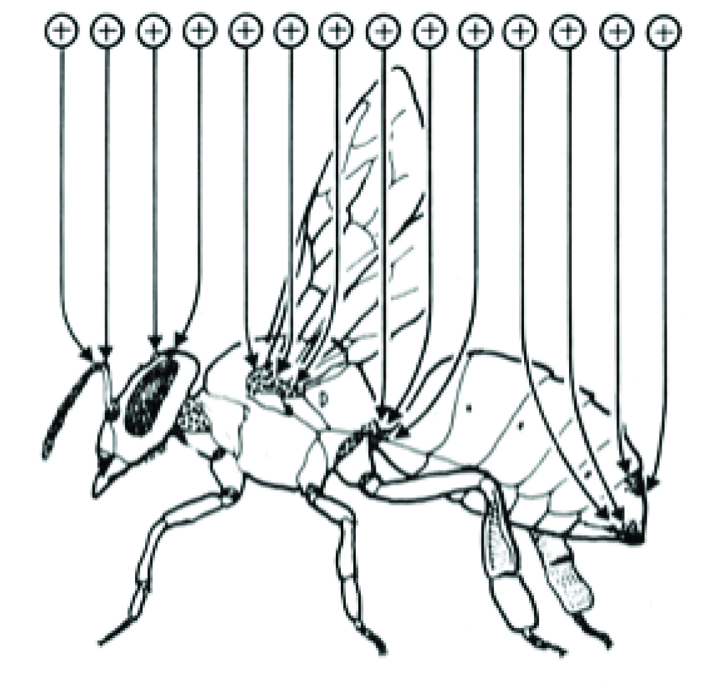
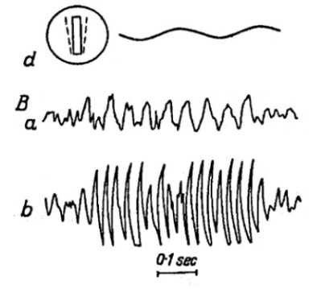
Charge by air friction
Highly insulated insects charge
their cuticula during flight.
U. Warnke 1973
ESF signal of a dummy wing
Yeskov 1967
Notes:
Insects accumulate charge mainly during flight as we know from Yeskov and Warnke, among others. When I started to work in the lab we were puzzled by the observation that bees tended to land on a flower making first contact with the proboscis sticking out. Must be as touching a 9-Volt Battery with your tongue!

Slide 3
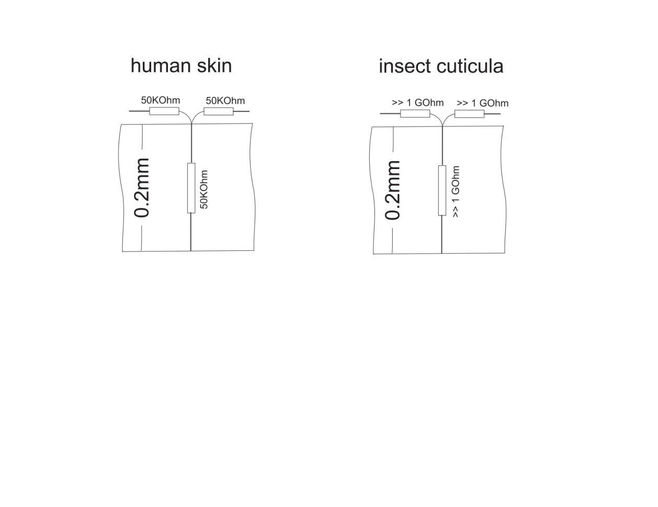
Conductivity of human skin and the exoskeleton of insects
There is no relevant current flow on the surface of insects as proposed by previous authors!
Notes:
So what’s new? Previous authors suggested the presence of a flow of current on the surface of the insect. However our point of view is that charge is fixed locally on the surface of the insect’s body. As you can see from the image on the right, the resistance of the clean cuticula is extremely high compared to our skin and prevents the flow of current in any direction especially for surface voltages below 100 Volts.
The moment we touch the door handle and feel the pain it reminds us that we are electrically charged. Lukily, when we touch a second time the charge has disapeared. This is completely different for an landing insect. It will loose some charge from its tarsae but all the other body charge might stay for days.

Slide 4
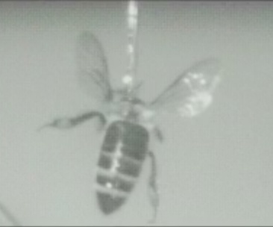
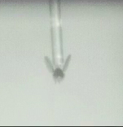
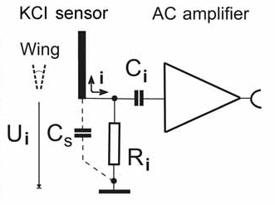
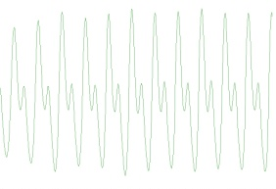
The electrically charged wing
The charged wing as the fast-moving body part emanates an alternating electric field. The dynamics of this field can be recorded by a remote electrode connected to an AC amplifier or displayed as the mechanical movement of the receiving flagellum.
Bee with four wings !
Output voltage
Drosophila
Björn Brembs
To measure a DC-potential remotely, a chopper device is needed. For insects, this is provided by the wing.
Notes:
For high performance communication you need a strong sender. But what is the surface potential of the sending body parts of the honeybee?
To measure a DC-potential remotely, a chopper device is needed. For insects, this is provided by the wing.
The charged wing swings close to the electrode of the electrometer amplifier giving the about 100 percent value and afterwards it swings away up to 8 mm resulting in a near-25% value according to the distance role in Coulombs law at frequencies of 120-250 Hz.
So far for the bee. Drosophila's wing beat is to short to elicit a strong modulation but is still detectable.

Slide 5
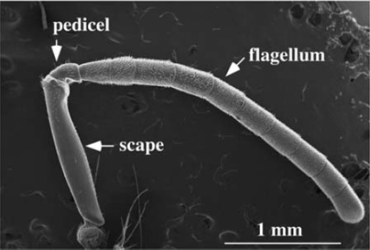
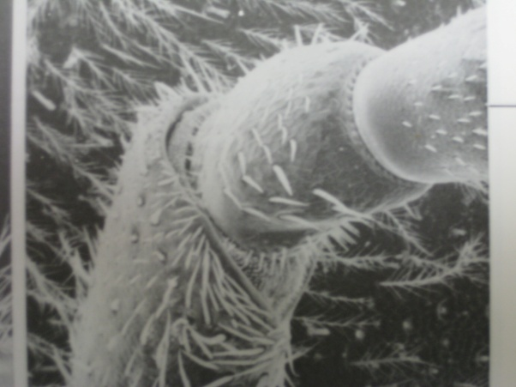
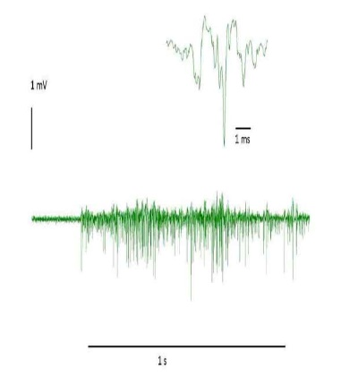
The bee’s ear
Flagellum with Johnston’s organ (multiple mechanoreceptors)
Tsujiuchi, S., Sivan-Loukianova, E., Eberl, D. F., Kitagawa, Y., and Kadowaki, T. 2007
For communication you need a sensitive receiver as well
Notes:
For successful communication you need a sensitive receiver as well. Hearing is supposed to be designed with a very low threshold of a mechanoreceptor. A deflection of the flagellum of just a few nanometers causes a nervous system response in the Johnston's organ.

Slide 6
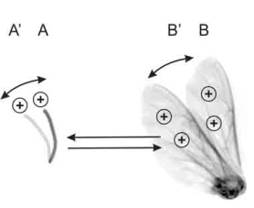
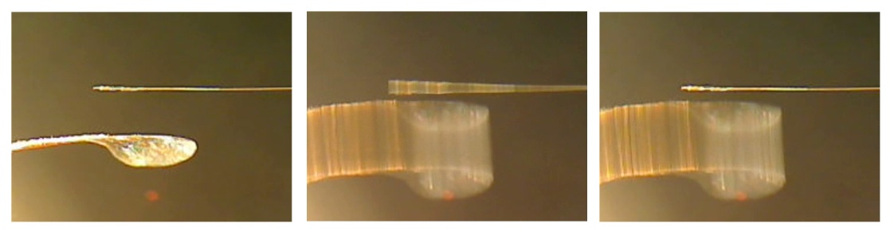

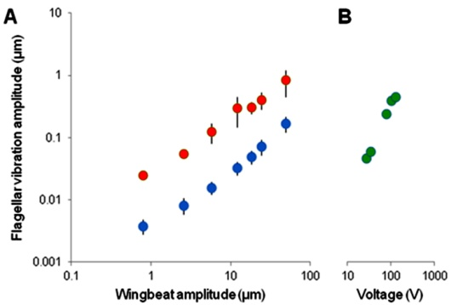
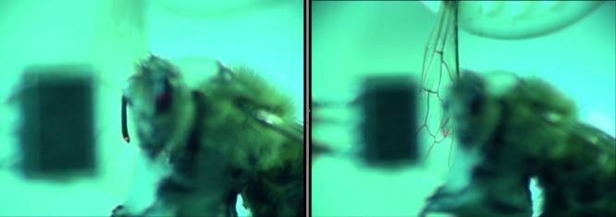
Response of the flagellum to the wing beat
Coulomb forces of wing and flagellum
F
Acoustic versus electric forces
Do honeybees have hearing?
Laser Doppler vibrometry
Threshold of hearing is less than 10nm of flagellar vibration
Vibration amplitude of the antennal flagellum as a function of the oscillation amplitude of an isolated wing placed at a distance of 2 mm from the bee’s head. (Red charged wing, blue acoustic coupling.)
Coulomb forces are easily more the 10 times stronger than acoustic forces especially for frequencies less the 50 Hz
Notes:
A simple experiment demonstrates the remote forces between the flagellum and the wing based on Coulomb’s law.
Electric coupling of wing and flagellum. Left: The flagellum is glued to the tip of a human hair, which simulates the muscle force and joint flexibility of the flagellum. The wing is mounted to a thin plastic stick driven by a loudspeaker with its sound suppressed and placed at a distance of 3mm from the flagellum. Middle: The wing vibrates at the resonance frequency of the hair to keep the coupling force at a minimum. The wing swing amplitude is 3mm . Right: Discharged flagellum (or wing). The coupling effects from the acoustic force can only be seen at high resolution. This demonstrates that the driving electric force F is proportinal to the product of Q_{flagellum} and Q_{wing} according to Coulomb’s law. When one of the charges Q_{flagellum} or Q_{wing} is zero or neutral, an electric field but no force can be detected between the body parts.
Using modern laser Doppler vibrometry we can demonstrate the sensitivity of the hearing. Secondly, this illustrates that the electric force is easily more than 10 times as effective as the acoustic force.
A. Vibration amplitude of the antennal flagellum as a function of the oscillation amplitude of an isolated wing placed at a distance of 2 mm
from the bee’s head (oscillation frequency: 40 Hz, n ¼ 3 flagella, means+1 s.d. Vibration amplitudes were measured as Fourier amplitudes at the frequency of oscillation.
Grey symbols: wing charged by contact to a piece of charged Styrofoam, black symbols: wing uncharged so that the flagellum is only driven by air flow.
B. Flagellar vibration amplitude as a function of the voltage amplitude of a 40 Hz sinusoid fed to an electrostatic probe placed at a distance of 2 mm from the bee’s head. Statistics: uncharged versus charged bodies differ significantly (d.f. ¼ 1, d.f.error ¼ 6, F ¼ 8.15, p , 0.029, ANOVA for repeated measures).
At frequencies below 50 Hz the acoustic force fails completely due to an “acoustic shortcut”. The Waggle frequency is about 16 to 20 Hz.

Slide 7
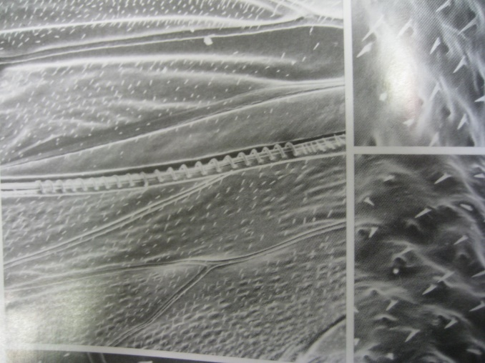
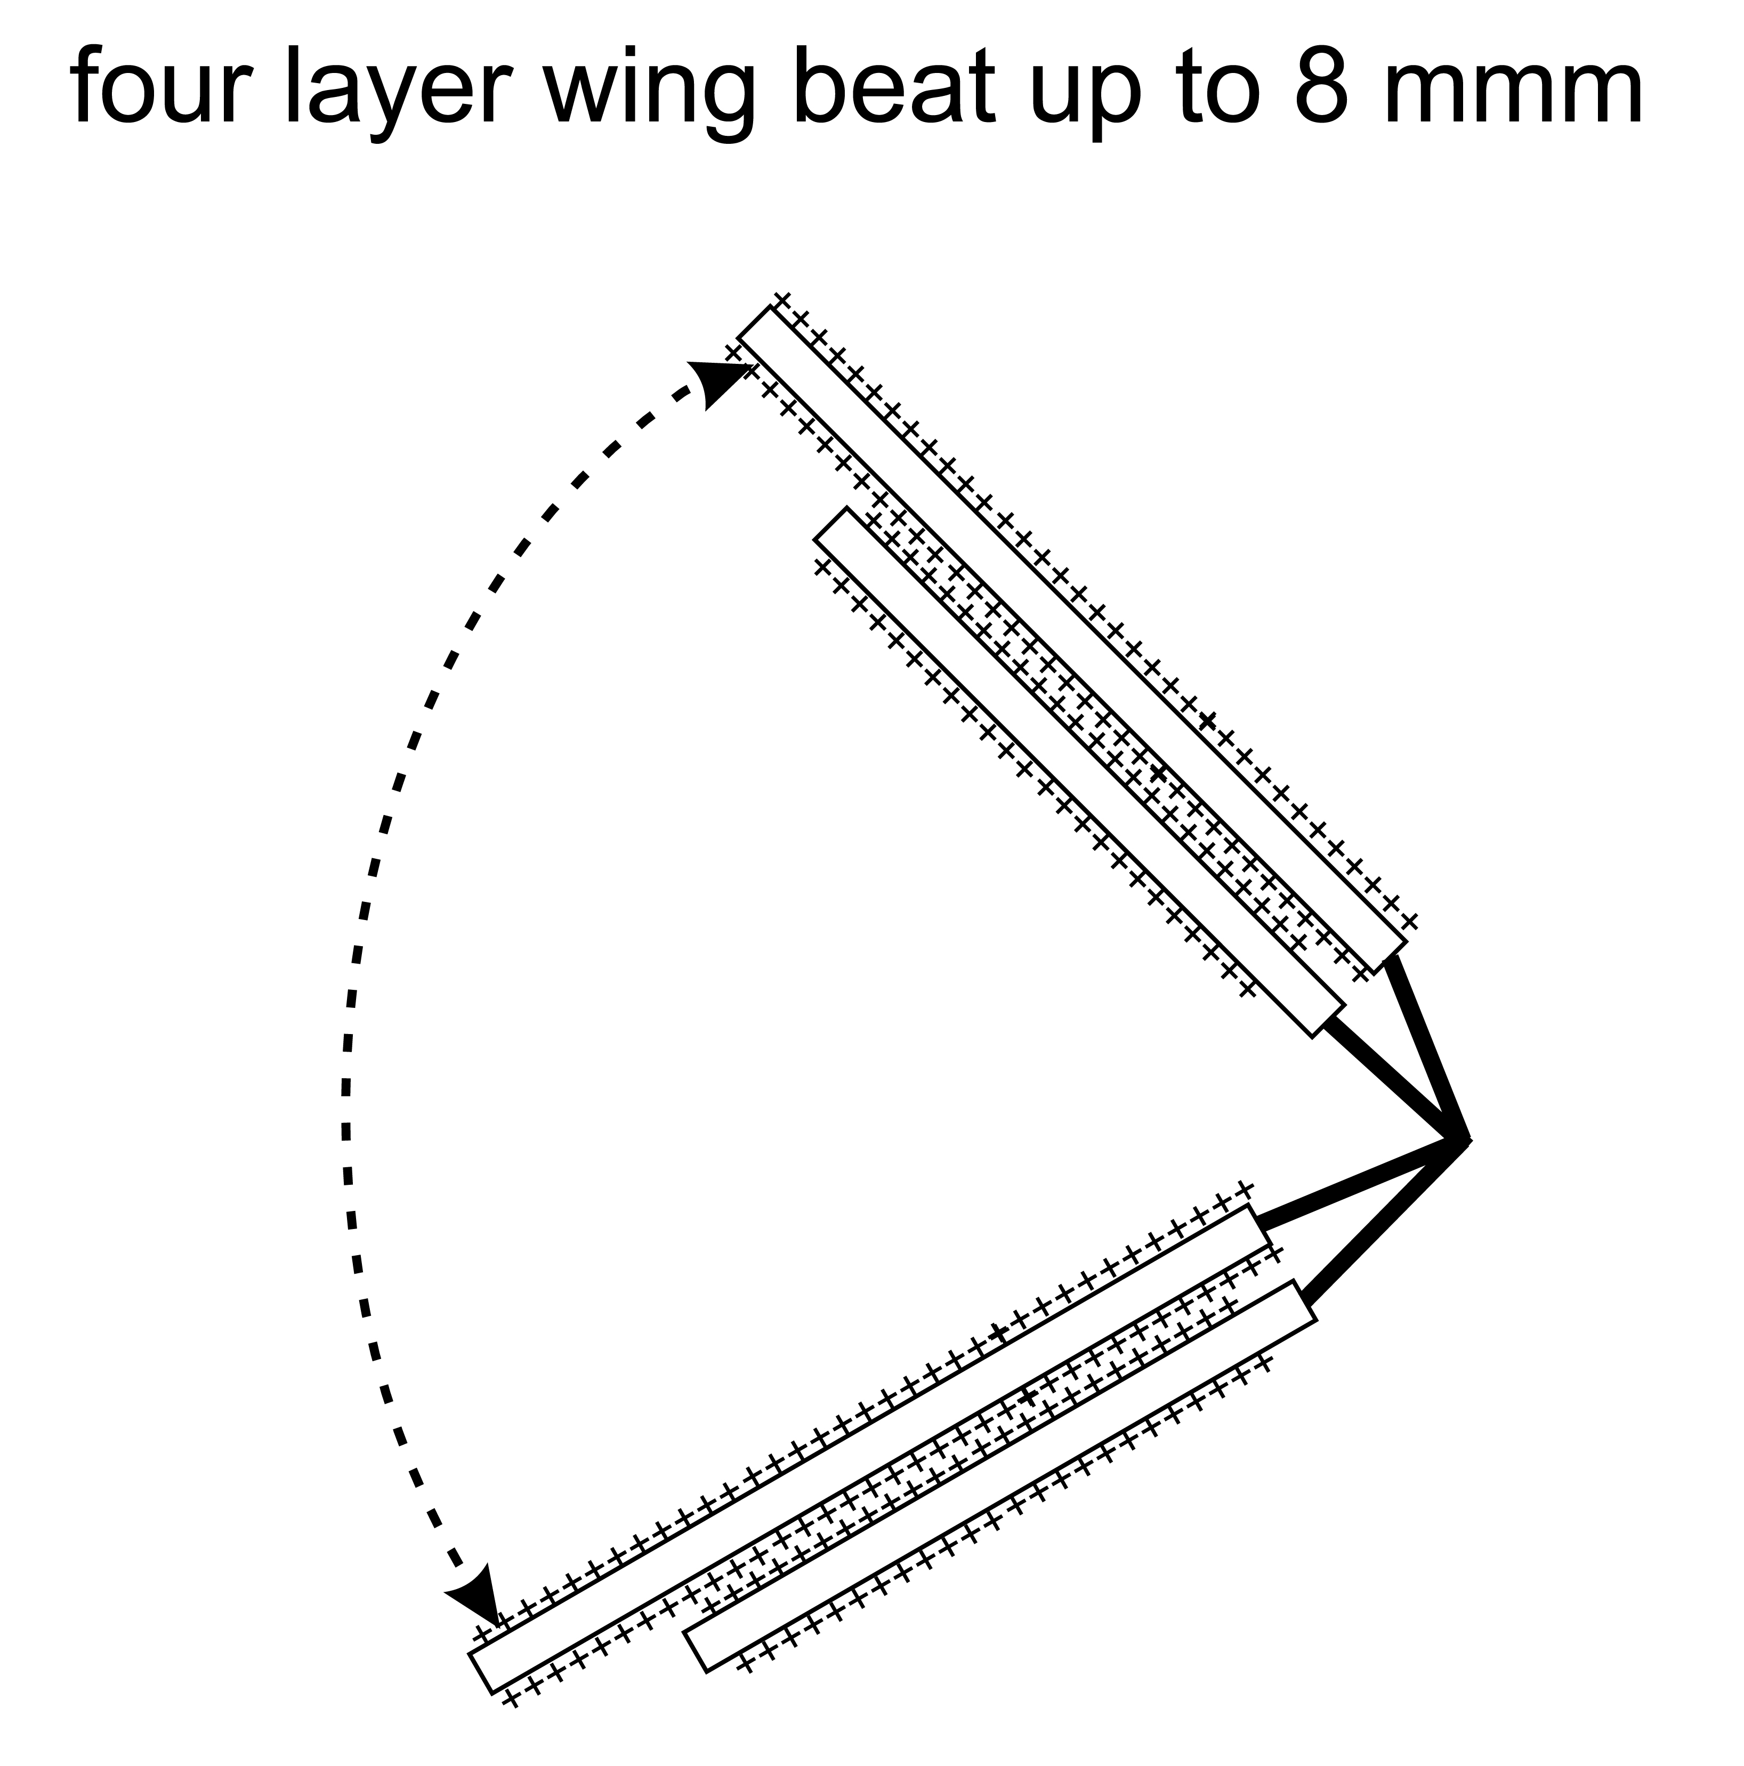
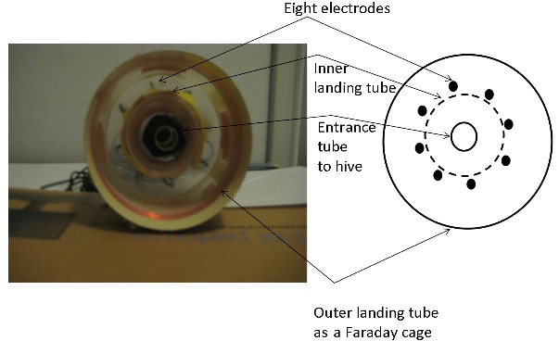
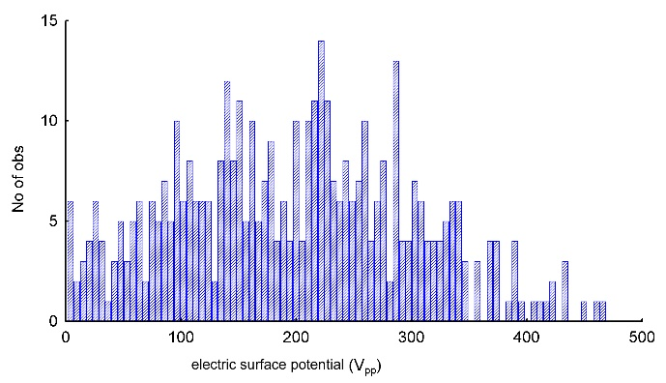
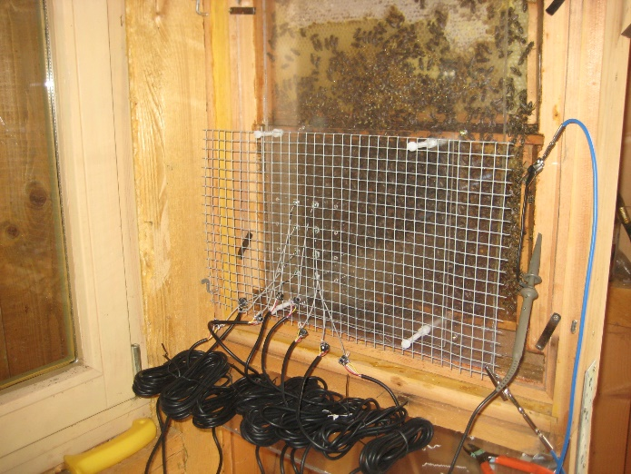
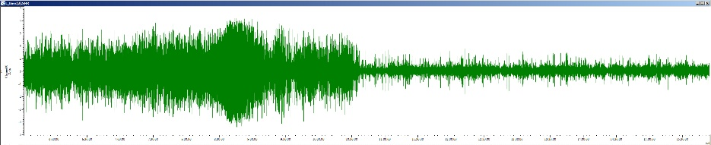
During landing flights with four wings
27°, 45%
rel. Humidity
Effective voltage of a four-layer wing
The natural humidity influences the electric signal on the comb
sunshine in the morning rain in the afternoon
30% rel. Humidity
60% rel. Humidity
Time course of day
Notes:
The maximum Coulomb force is achieved by a four-layer wing which carries 4 times the charge of a single surface under natural condition in front of a hive.
Signal amplitudes of electrodes on top of the comb decrease easily by a factor of 20 when the humidity increase during a rain fall.

Slide 8
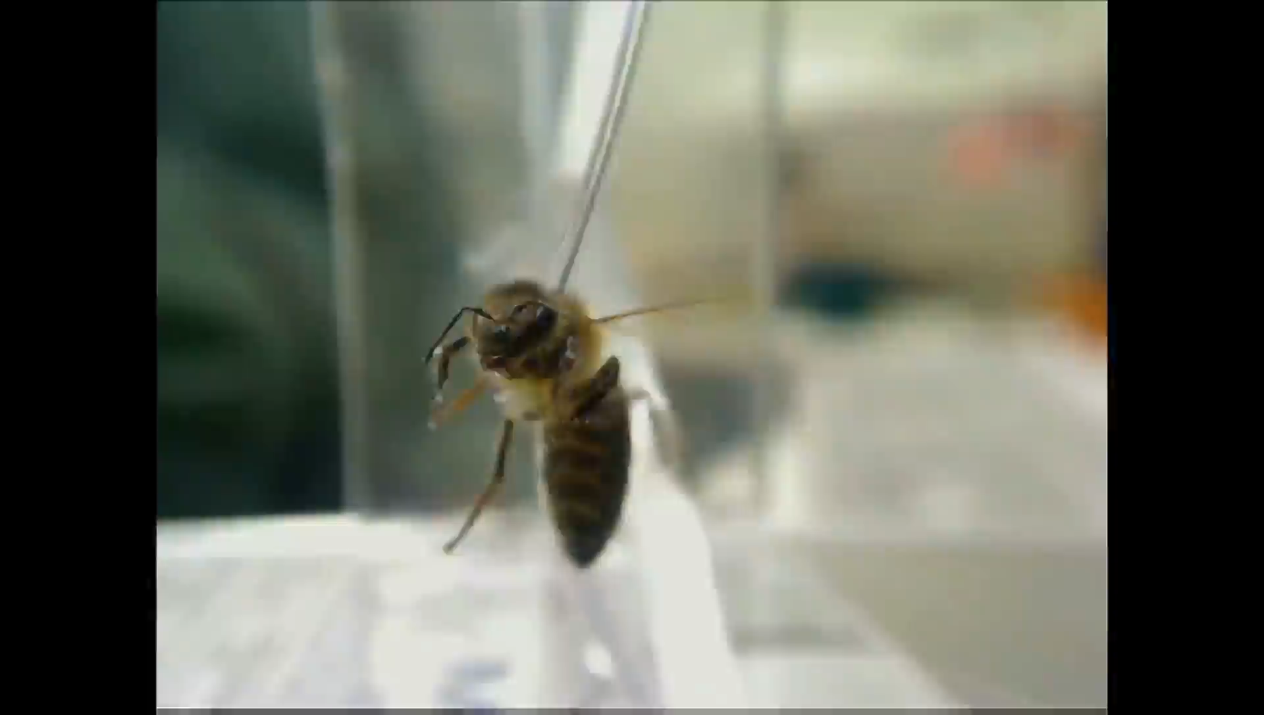
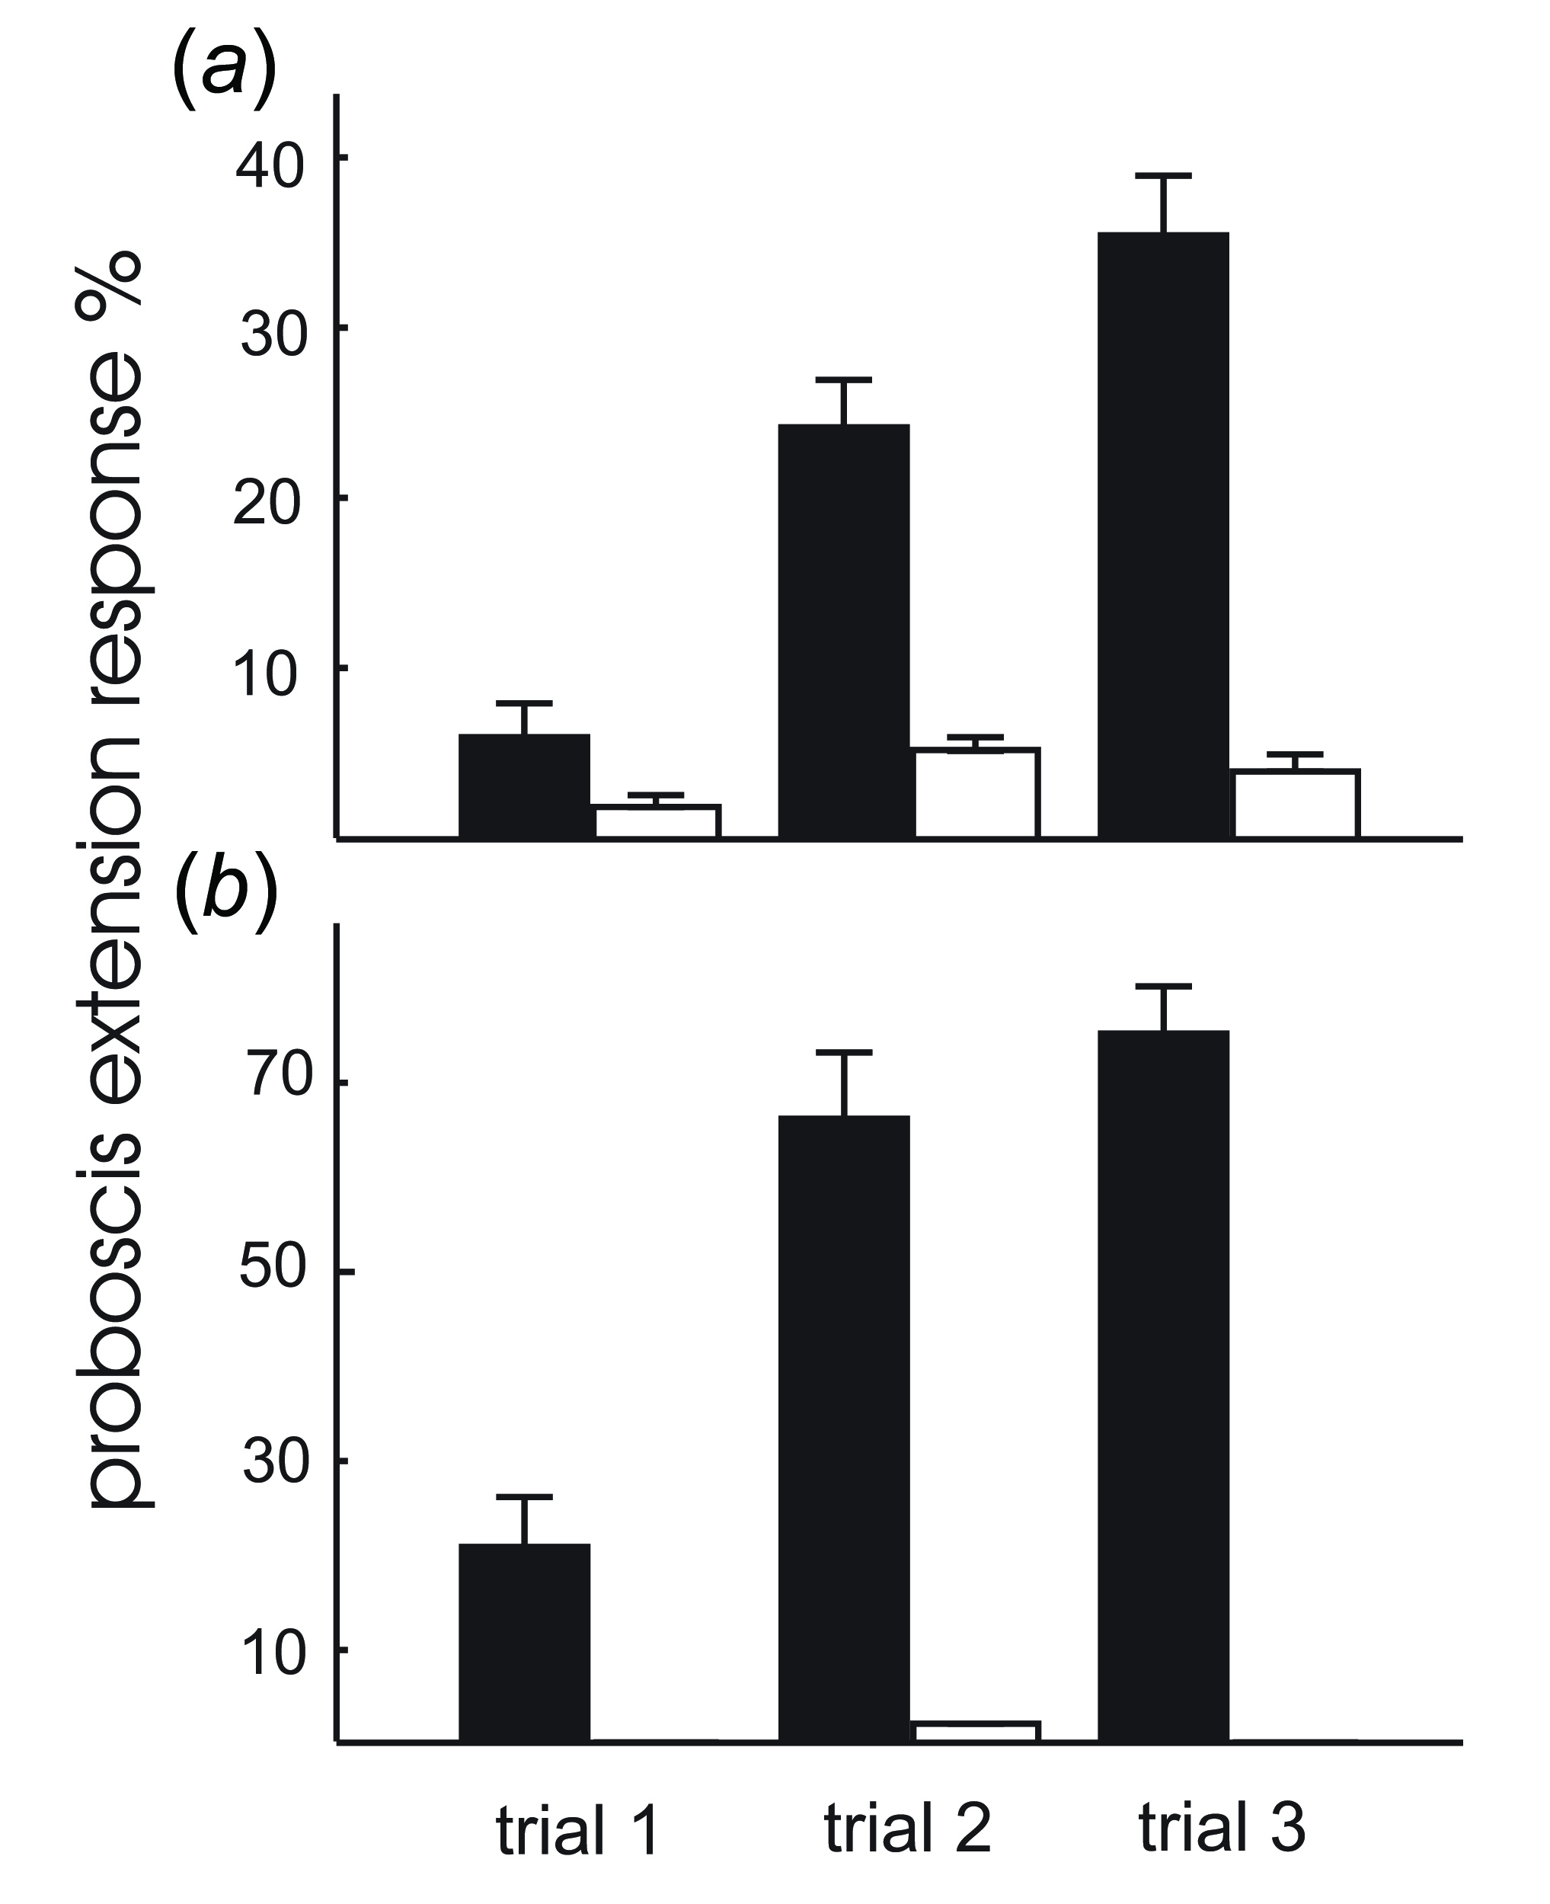
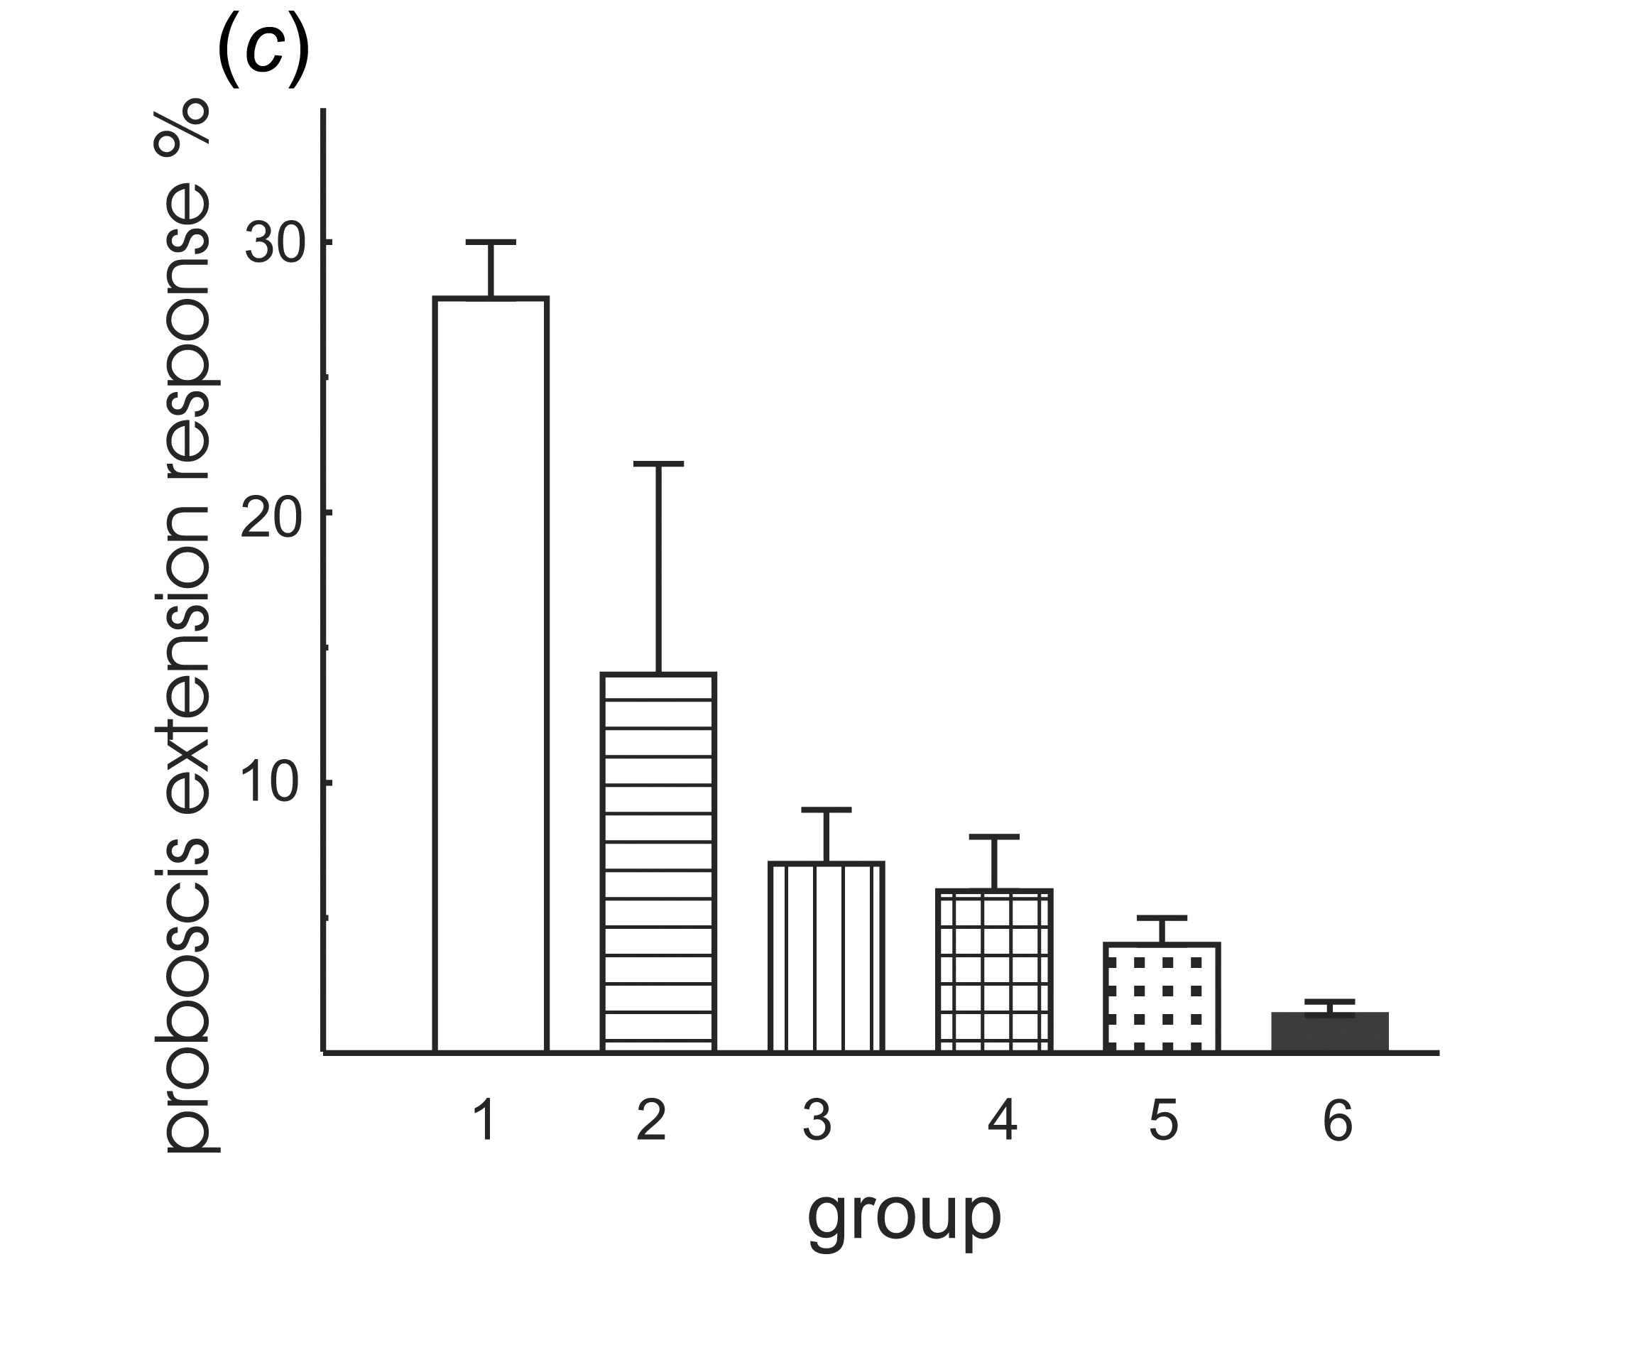
But what is its relevance for the animal?
Differential conditioning of PER (Gesche Koch)
CS+: charged Styrofoam
CS-: uncharged Styrofoam (not shown)
black CS+
white CS-
Styrofoam stimulation
Any kind of manipulation of the antenna reduces learning ability
Antenna free
All response values to the CS + are significantly different to those to
CS- (between groups: d.f. = 1, d.f.error = 96, F = 133.67, p , 0.01
ANOVA repeated measures, between stimuli: d.f. = 2, d.f.error = 192,
F = 7.713, p , 0.02 ANOVA repeated measures).
(c) The effect of manipulation
of the antennae on the CR to a constant electric field as provided by
charged Styrofoam. Group 1: no preparation of the antennae (control group).
Group 2: the flagellae were coated with wax. Group 3: the scapus was fixed
to the head. Group 4: the antennae were fully covered with wax, but joints
between flagellum and pedicel (JO) were free of wax. Group 5: antennae
were fully covered with wax. Group 6: antennae were removed. Group 1 is
significantly different from all other groups: d.f. = 5, d.f.error = 101,
F =74.5, p , 0.01 ANOVA repeated measures).
black CS+
white CS-
AC-stimulation
100Vpp, 60Hz
The response values for all three trials to the CS+ are significantly different to those to CS- (between groups: d.f. = 1, d.f.error = 52, F = 33.67, p , 0.01 ANOVA repeated measures, between stimuli: d.f. = 2, d.f.error = 104, F = 5.143, p , 0.001 ANOVA repeated measures).
Notes:
Video: This very slow movement of a piece of charged Styrofoam has absolutely no acoustic component, but can clearly be used to elicit the proboscis extension reflex of the bee according to Pavlov’s conditioning paradigm in a test after 24 hours. An identical uncharged piece of Styrofoam fails to elicit a response.

Slide 9
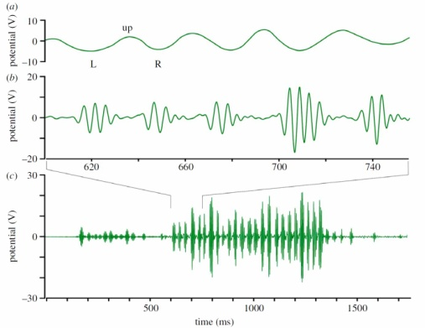
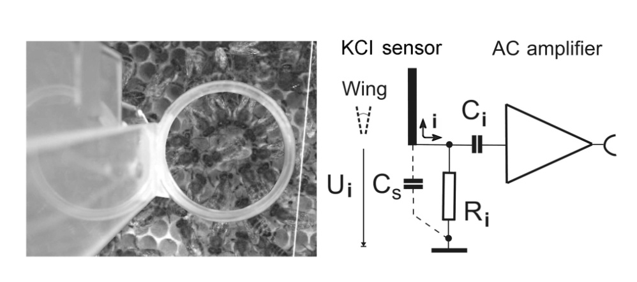
Electric signals in dance communication
abdomen waggle 16-19 Hz
Dancer surrounded by followers
whirring wings 230 Hz
230 Hz
- waggle phase -
24 whirring pulses coding a distance of 720 m
Notes:
So, what role do electric signals play in dance communication? Using a potassium chloride sensor you can record the electric signal components of a dance. The dance comprises 2 components: a low-frequency component caused by the abdomen and a high-frequency component caused by the wings. The number of pulses code for the distance to the food source, in this particular case 24 whirring pulses, each of which signals 30 meters.
F0 16.67 Hz T0 60msec Abdomen left/right T2 30msec coding 30m per left or right waggle 1km 33 pulses a 30m or 16.67 pulses a 60m

Slide 10
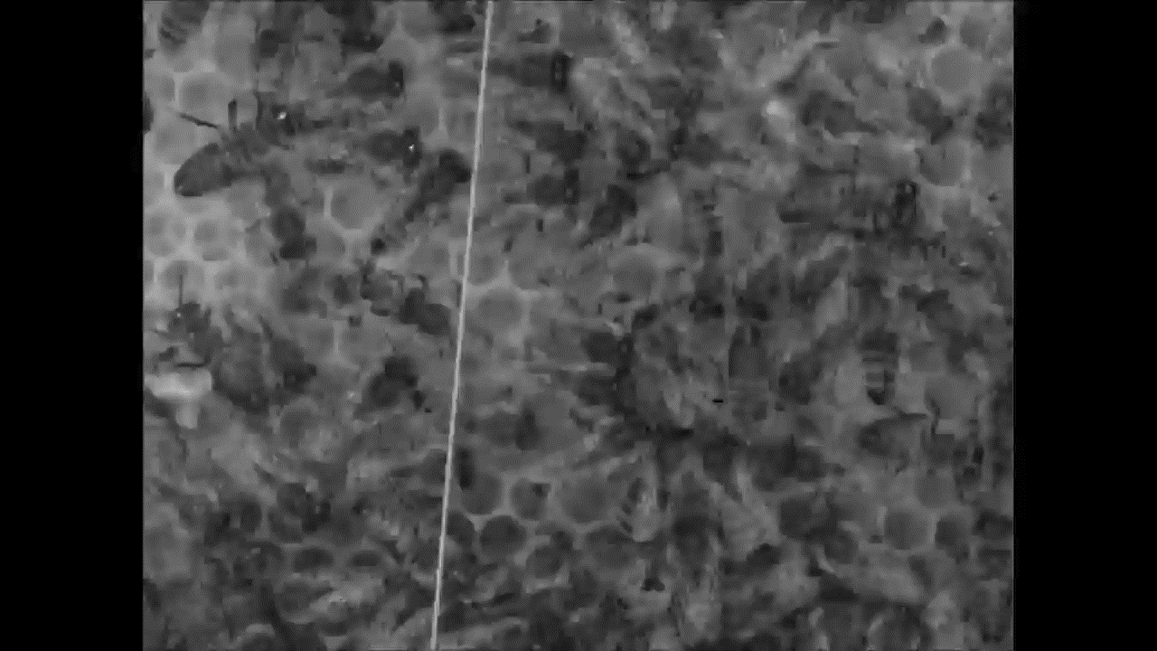
Circular formation during the waggle dance
Notes:
Here you can see how up to 12 followers attend the dancer in a circular formation. Notice the random distribution of the body axes of the followers during the return run.

Slide 11
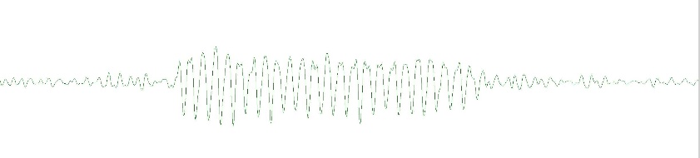
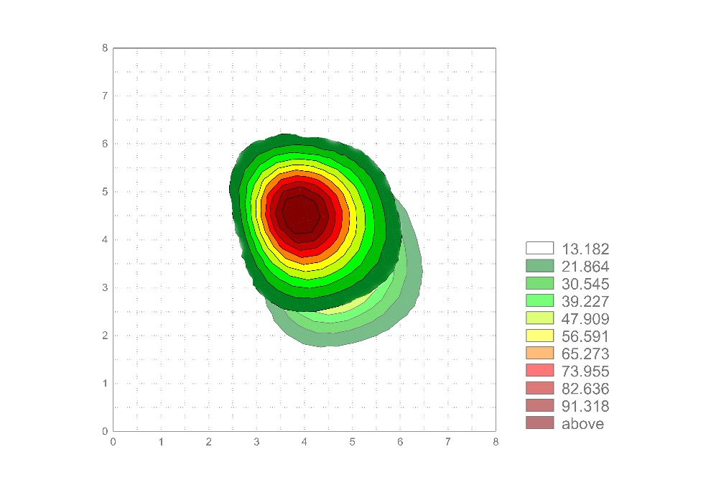
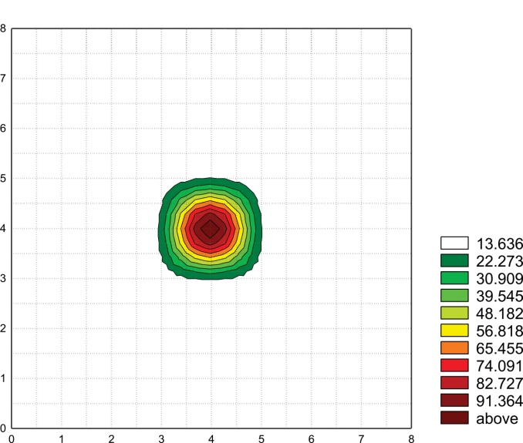
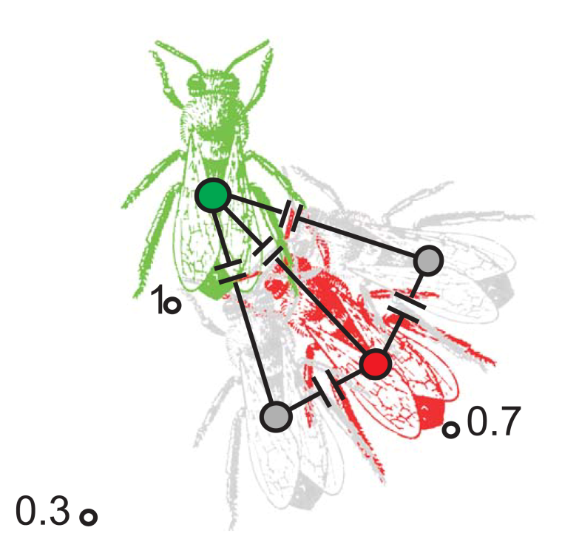
Reading the dance vectors recorded by an
electric ‘camera’ with 32 pixels (electrodes)
o
Reading the dance vector 330 1440 m transformed according to the time course of the day for the sun
Single fanning bee
as a point source
The signal strength drops to ~ 25%
according to Coulomb’ laws over
a distance of one cm
24 abdomen pulses
coding 24 x 60m
Capacitive coupling between dancer and 3 followers
as a consequence of the bee’s haemolymph (permittivity ~ 80)
o
330
Notes:
Using an array of more than 32 electrodes both the direction of the dancer and the distance coding are revealed. During a 24-hour period of observation we can record the complete distribution of dances towards the colony’s food sources.

Slide 12
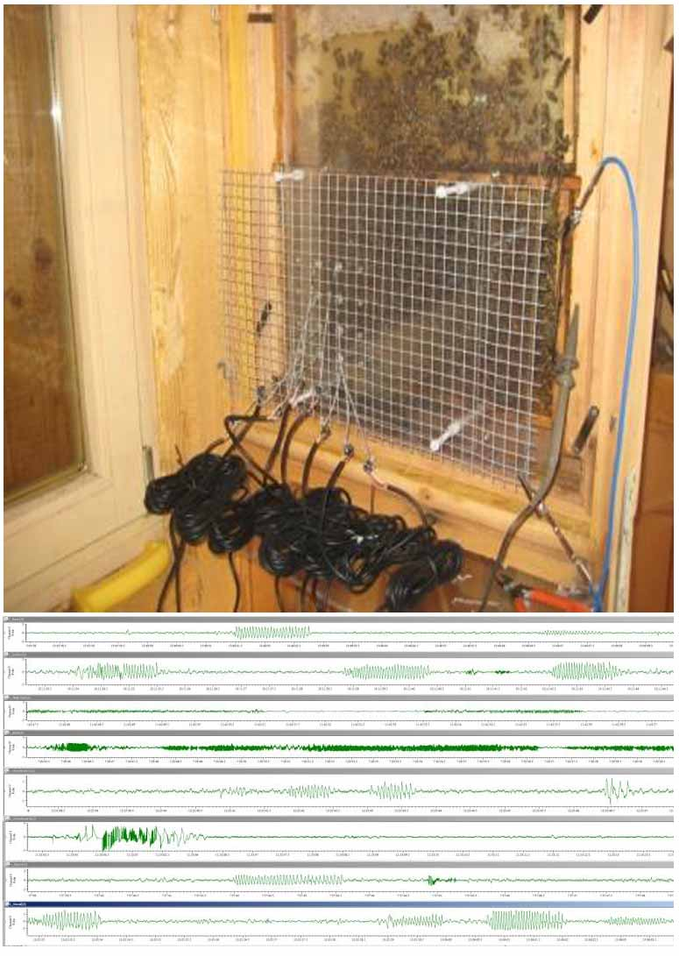
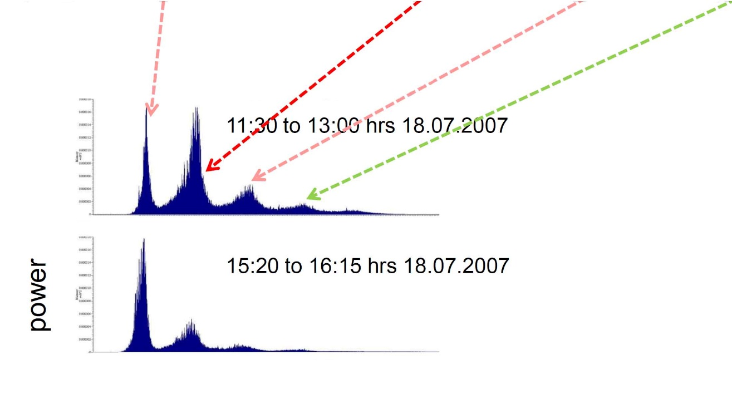
Fingerprints of activities on the comb
waggling fanning whirring stop tones
16 120 230 300
16 120 230 300
frequency[Hz]
Notes:
With multiple electrodes attached to the dance floor of an observation hive we can record the dances of the colony over consecutive 24-hour intervals. The different tasks of the bees on the comb are reflected in specific “fingerprint” frequencies in the power spectrum.

Slide 13
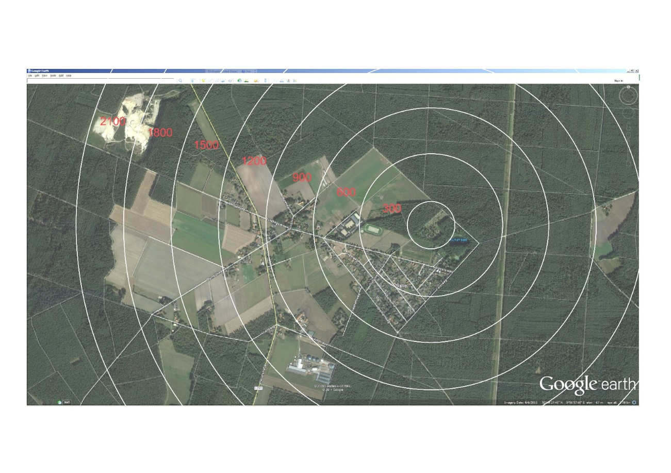
Environmental monitoring evaluated by bees
Frequency of waggle runs
Blossoming fruit trees
Distance in the dance [m]
Notes:
So, how can put these finding to practical use? Environmental monitoring in our case is based on the health status of the colony. Our approach is not to measure physical parameters such as pollutants, but to evaluate behavior in the hive with respect to its health. The dance distribution can function as an indicator of the presence of pollutants in the bee’s immediate environment.
Measuring a single physical parameter, the strength and modulation of the electric field emanating from the colony, provides deep insights into all of the colony’s activities including dancing, fanning, rapid body movements, generation of stop tones and even an evaluation of the humidity in the air of the hive.

Slide 14
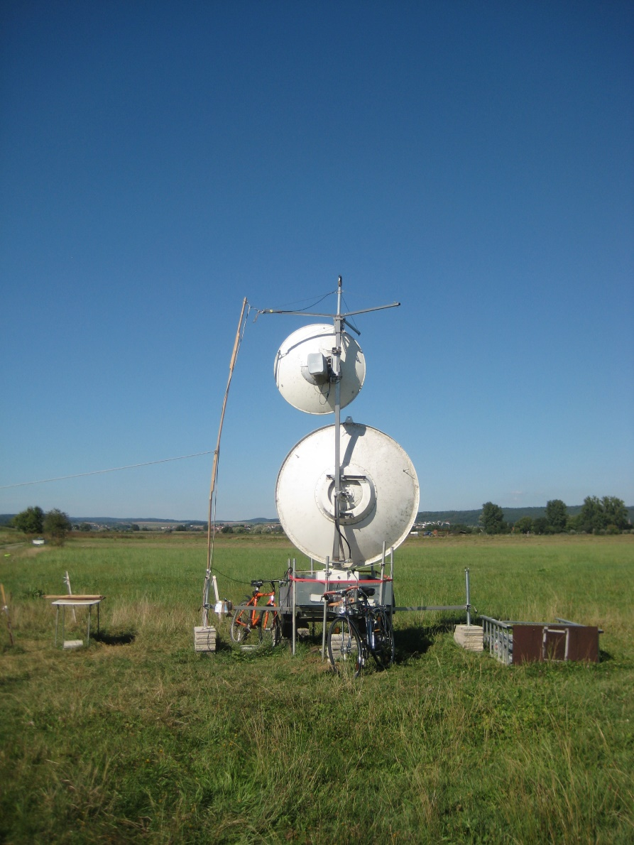
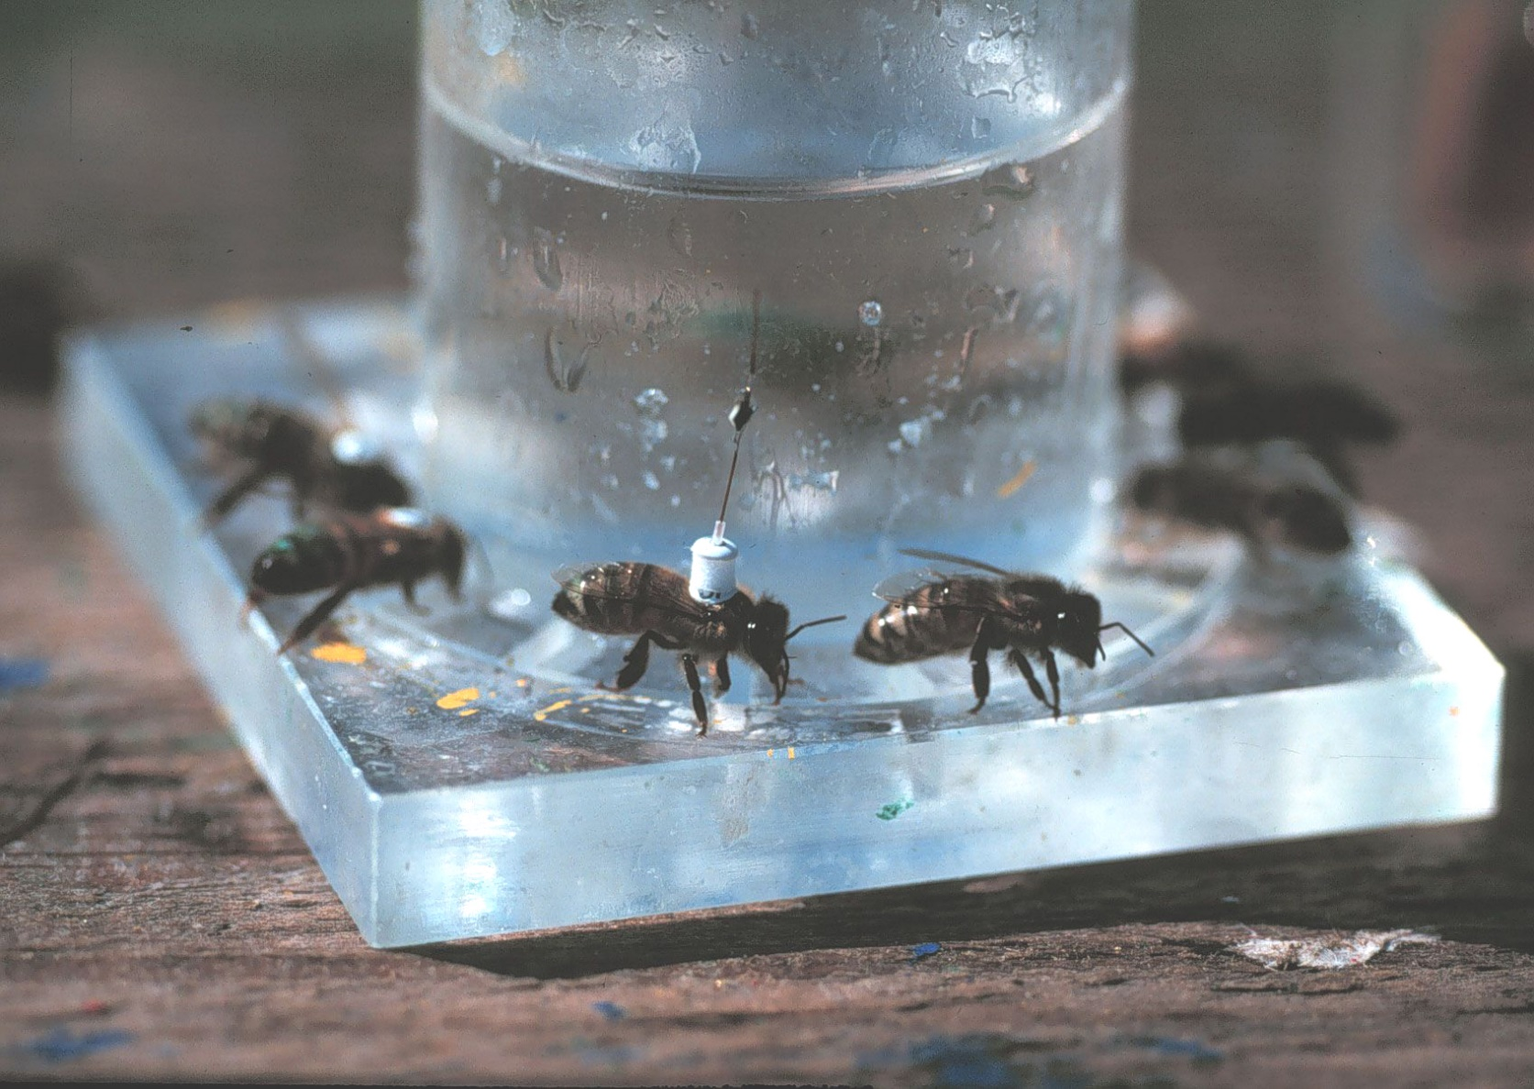
Harmonic radar tracking Bee with transponder at a feeder
Large antenna dish 9 Ghz 25kW small 18Ghz 11mm dipole, RF-diode (nonlinear)
Notes:
The interpretation of this environmental monitoring can be extended by a study of the bee’s cognitive map. Using harmonic radar we explore detailed information collected by the colony about their immediate environment. The bees are not just feeding from food sources like robots but learn a variety of other features like reliable landmarks for navigation (especially homing) and possible nest sites for swarming. Some of these features can be read directly from the dance and help us to predict whether the colony is able to survive in its environment.

Slide 15
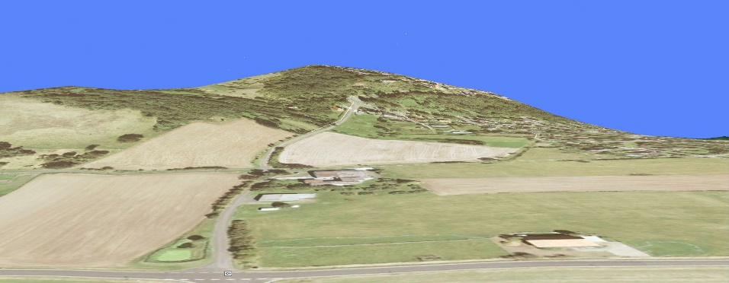
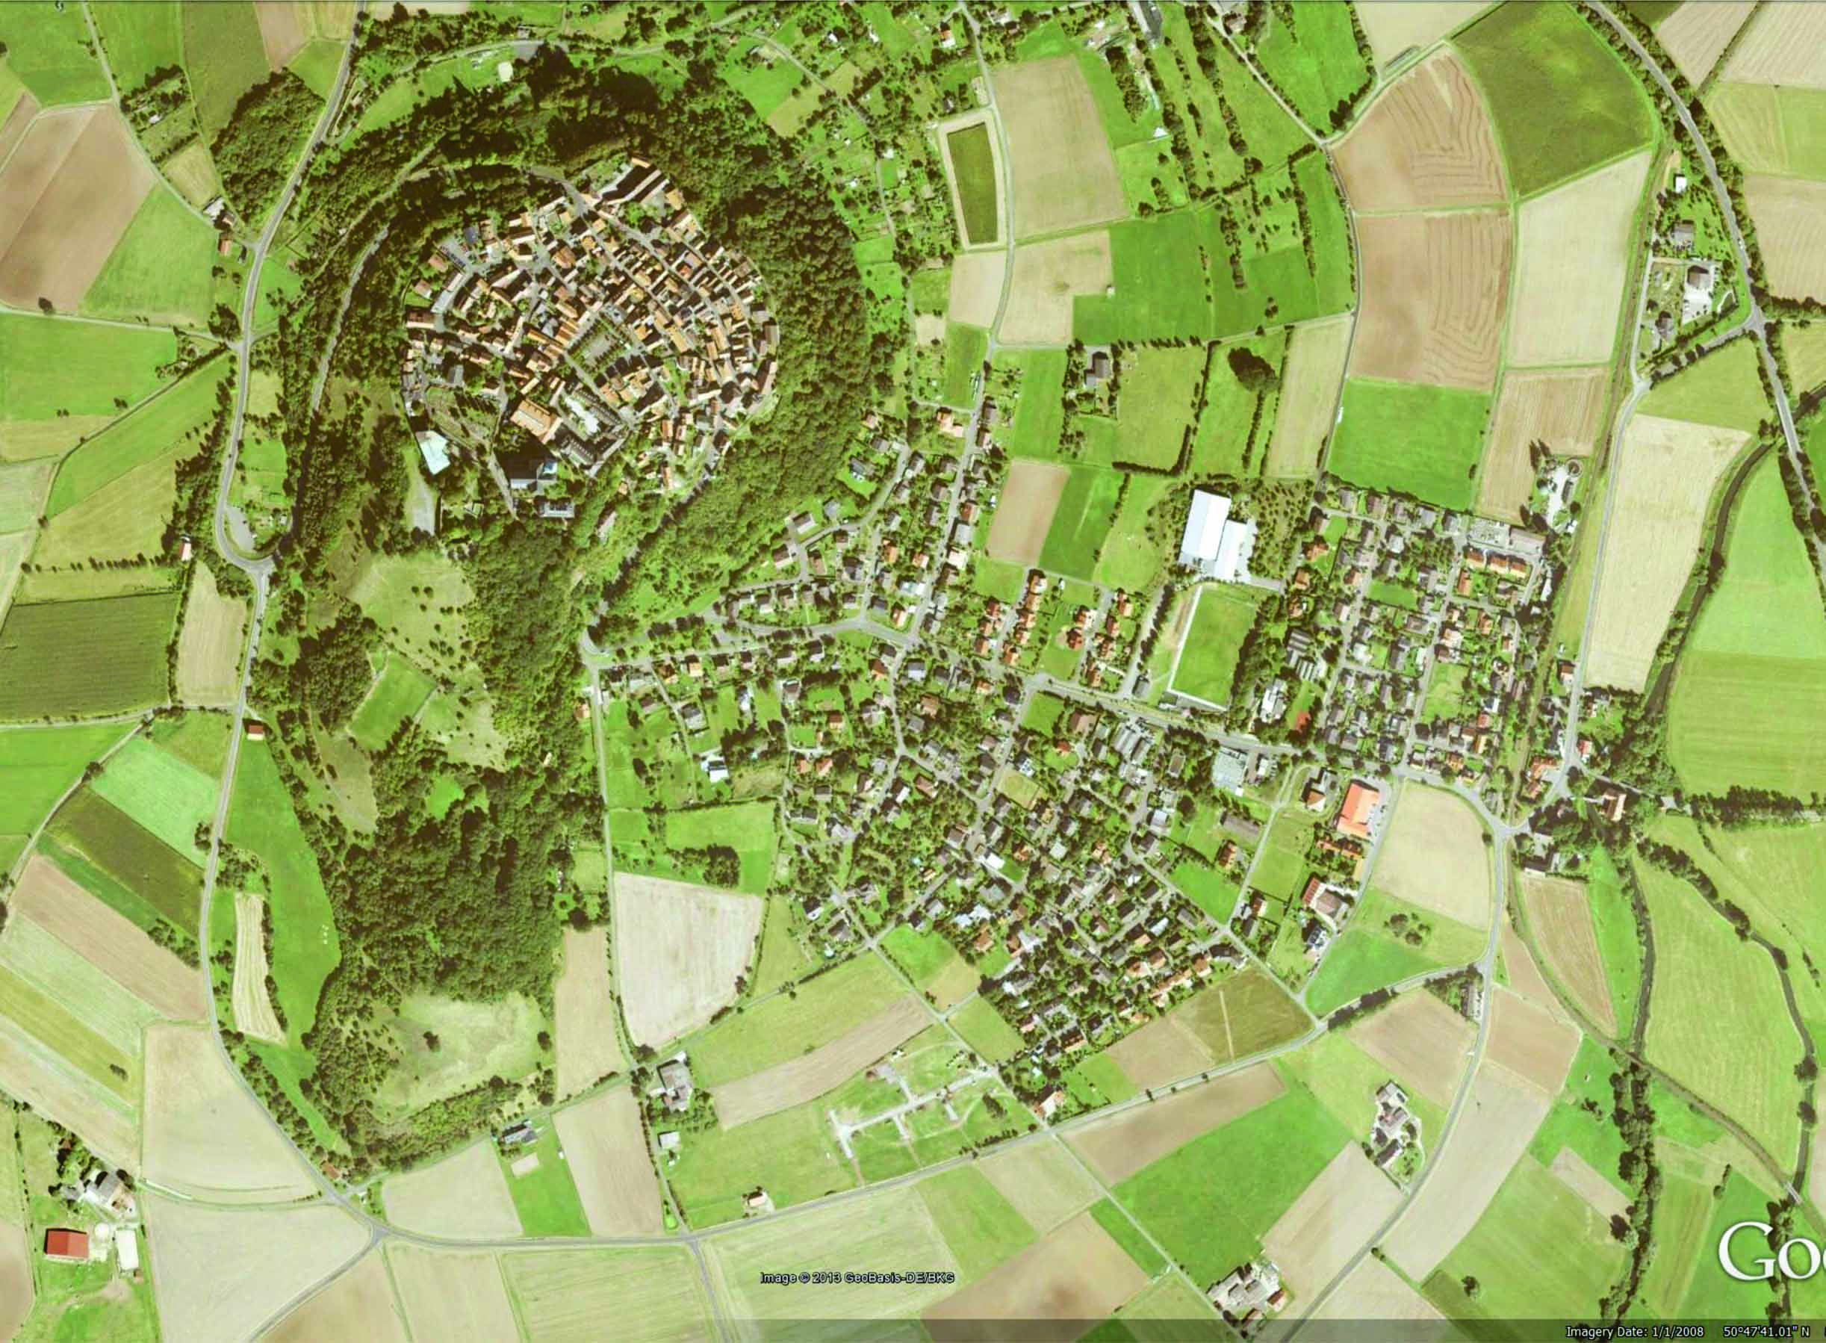
Features of the cognitive map in bees
100 m below the hilltop
Home area
Hive near a hill, located 575 m
from the market square on
the hilltop
----575– m------
Notes:
Imagine a colony living for some weeks on a slope near the foot of a steep hill. We collect a forager 10 m from its hive, feed it and displace it to a test area which is completely new to the animal about 4 km from the homing area .

Slide 16
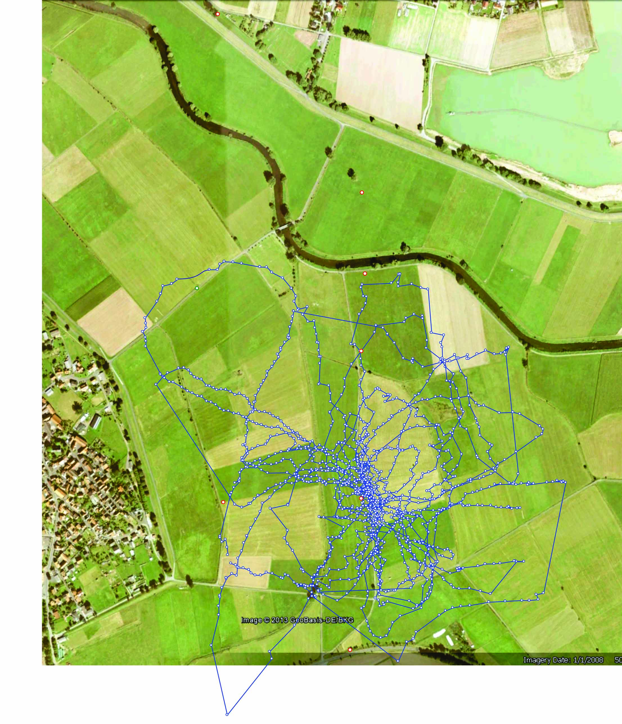
Bee lost in a completely unknown environment searching for its hive for about 2 hours.
First example:
Test field
Flat grassland with harmonic radar setup.
Harmonic radar
Release site
Notes:
At first glance the flight track appears to be random. Hardly any matching with prominent landmarks in the test field can be identified.

Slide 17
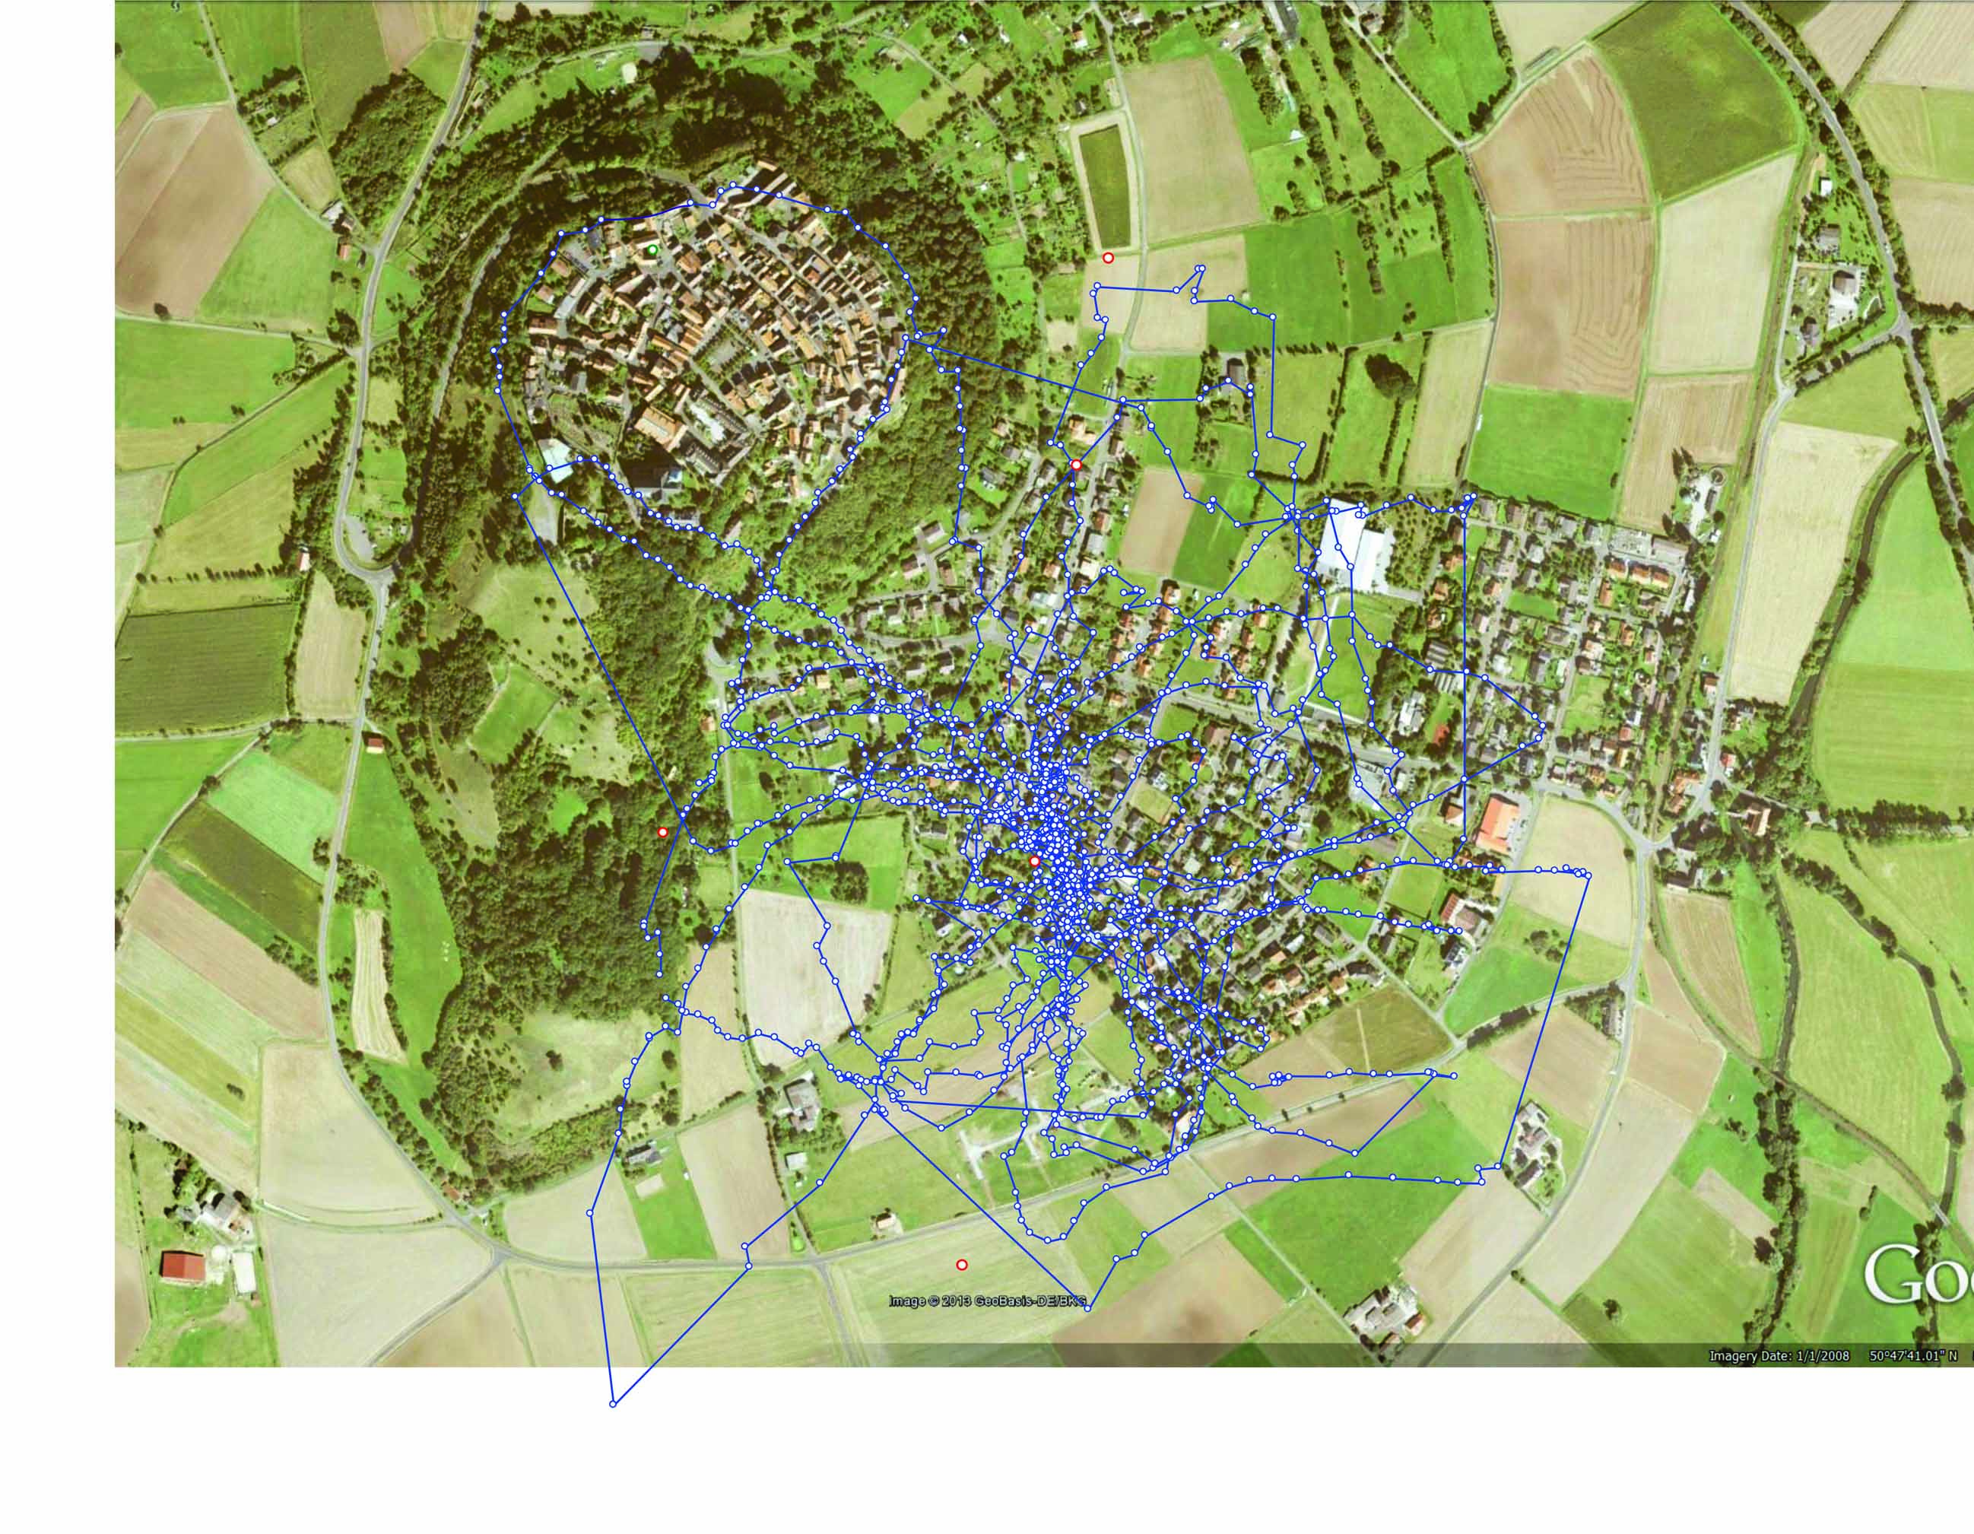
A trick: the recorded flight track is superimposed onto a google map of the home area
Notes:
When the seemingly random recorded flight pattern is superimposed onto the home area a much better match with dominant landmarks is revealed. This means that the bee is using its memory for a kind of ‘blind instrument flight’ in the test area. We interpret this track as a plot from the cognitive map of the animal. The animal is using its compass and the optical flow of the ground to manage this complex task.

Slide 18
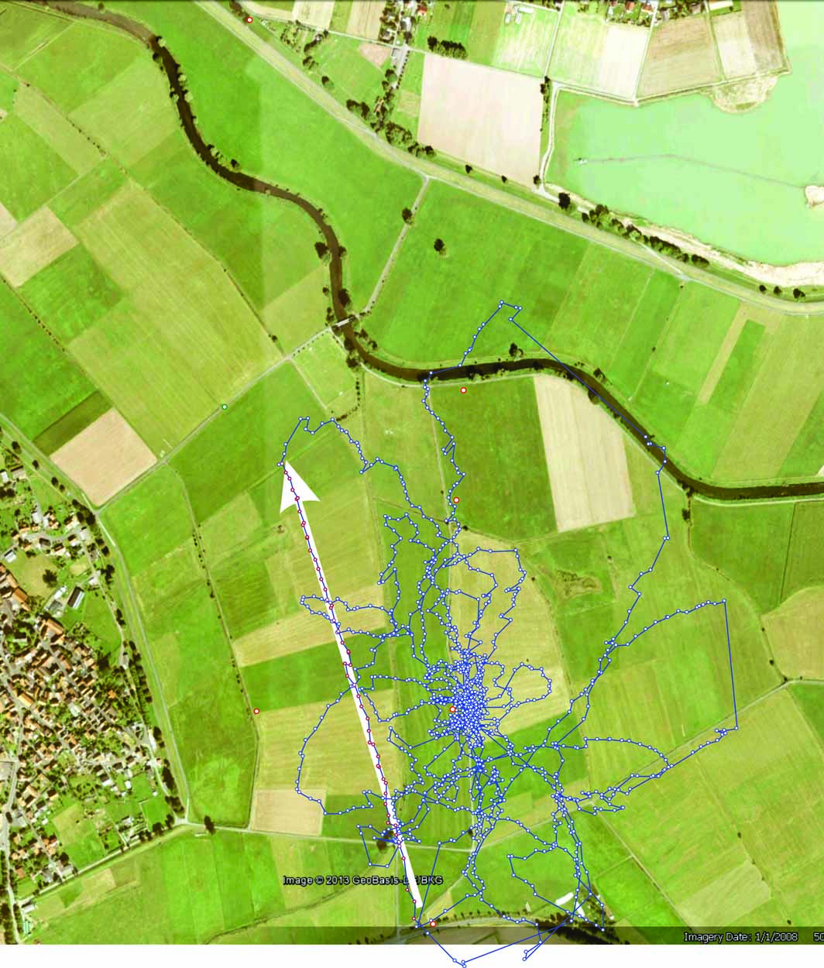
Bee lost in a completely unknown environment searching for its hive for about 2 hours.
second example:
Test field
Flat grassland with harmonic radar setup.
Harmonic radar
Release site
Surfaced road
Notes:
During the search flight this bee initiates a direct vector flight of 900 m with a deviation of +/- 8 m (radar error) starting from the only surfaced road in the area.

Slide 19
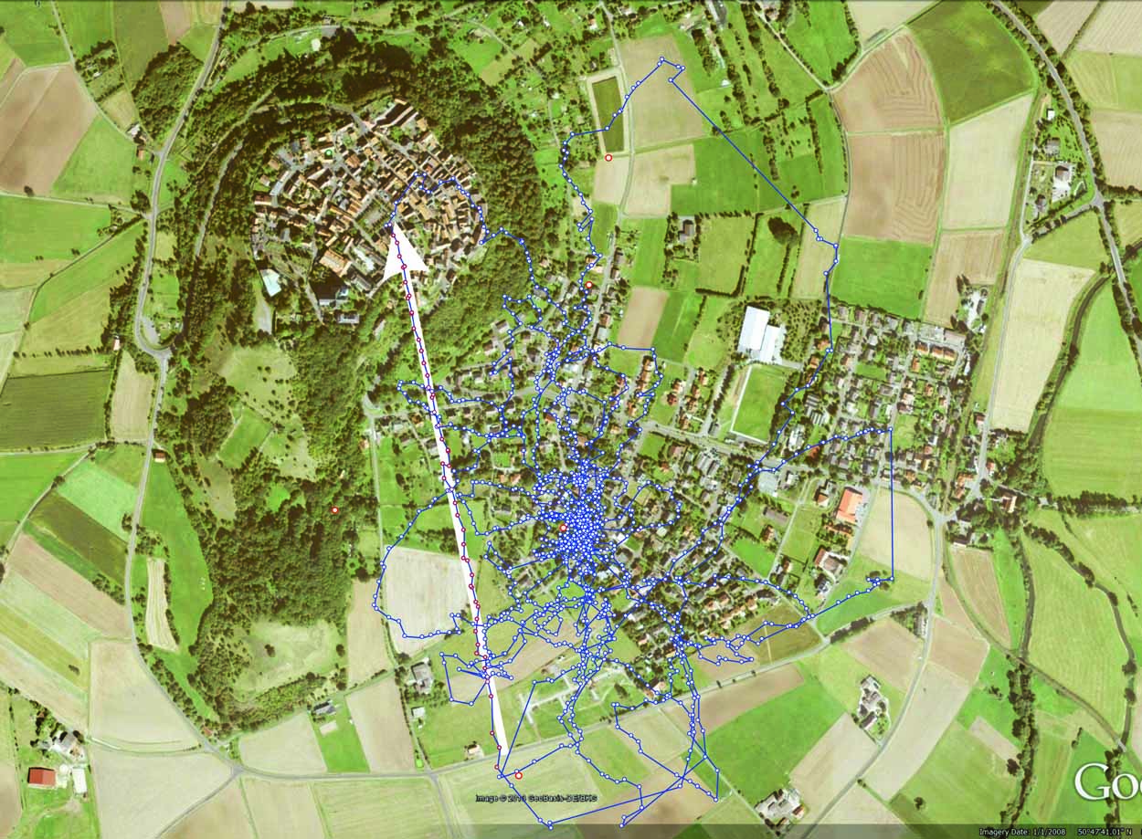
A trick: the recorded flight track is superimposed onto a google map of the home area
Surfaced road
Notes:
When we superimposed the recorded flight pattern onto the home area we found that there is also a surfaced road at the base of the vector. Our interpretation is that the bee recognizes the surfaced road as a known landmark in its environment therefore displaying typical generalization behavior. For the first time sure about its location, the bee tests for the most prominent landmark in its environment – the hill – and performs a direct vector flight.

Slide 20
Thank you!
The work presented here is a project of the research group led by Randolf Menzel at the FU Berlin, Germany.
Notes:
Again, thank you very much for the invitation. The work presented here is a project of the research group led by Randolf Menzel at the FU Berlin.

Slide 23
Capacitive coupling

